Slide 2
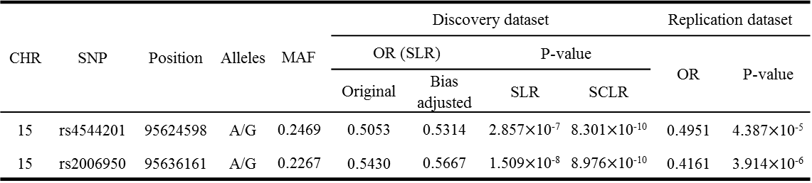
Table 1
CHR | SNP | Position | Alleles | MAF | Discovery dataset |  |  |  | Replication dataset
 |  |  |  |  | OR (SLR) |  | P-value |  | OR | P-value
 |  |  |  |  | Original | Bias adjusted | SLR | SCLR
15 | rs4544201 | 95624598 | A/G | 0.2469 | 0.5053 | 0.5314 | 2.857$×$10⁻⁷ | 8.301$×$10⁻¹⁰ | 0.4951 | 4.387$×$10⁻⁵
15 | rs2006950 | 95636161 | A/G | 0.2267 | 0.5430 | 0.5667 | 1.509$×$10⁻⁸ | 8.976$×$10⁻¹⁰ | 0.4161 | 3.914$×$10⁻⁶

Slide 3
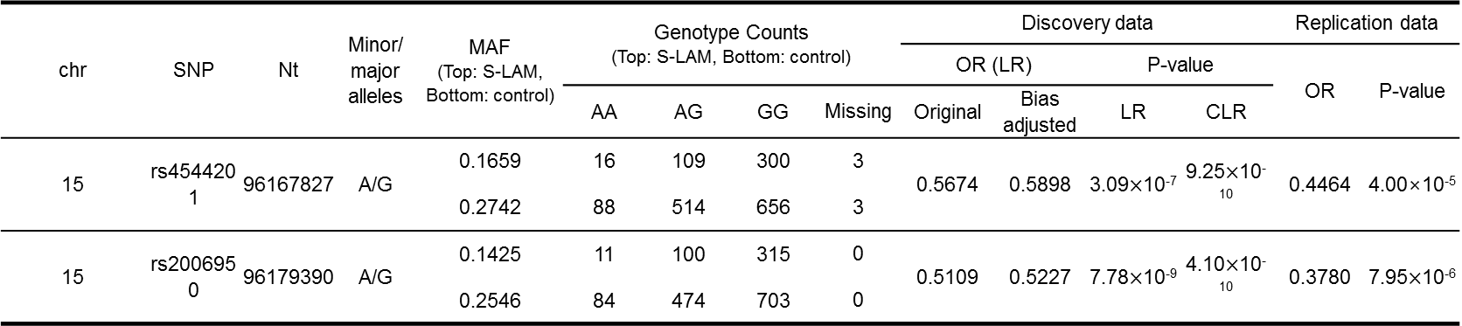
chr | SNP | Nt | Minor/ major alleles | MAF (Top: S-LAM, Bottom: control) | Genotype Counts (Top: S-LAM, Bottom: control) |  |  |  | Discovery data |  |  |  | Replication data
 |  |  |  |  |  |  |  |  | OR (LR) |  | P-value |  | OR | P-value
 |  |  |  |  | AA | AG | GG | Missing | Original | Bias adjusted | LR | CLR
15 | rs4544201 | 96167827 | A/G | 0.1659 | 16 | 109 | 300 | 3 | 0.5674 | 0.5898 | 3.09$×$10⁻⁷ | 9.25$×$10⁻¹⁰ | 0.4464 | 4.00×10⁻⁵
 |  |  |  | 0.2742 | 88 | 514 | 656 | 3
15 | rs2006950 | 96179390 | A/G | 0.1425 | 11 | 100 | 315 | 0 | 0.5109 | 0.5227 | 7.78$×$10⁻⁹ | 4.10$×$10⁻¹⁰ | 0.3780 | 7.95$×$10⁻⁶
 |  |  |  | 0.2546 | 84 | 474 | 703 | 0

Slide 4
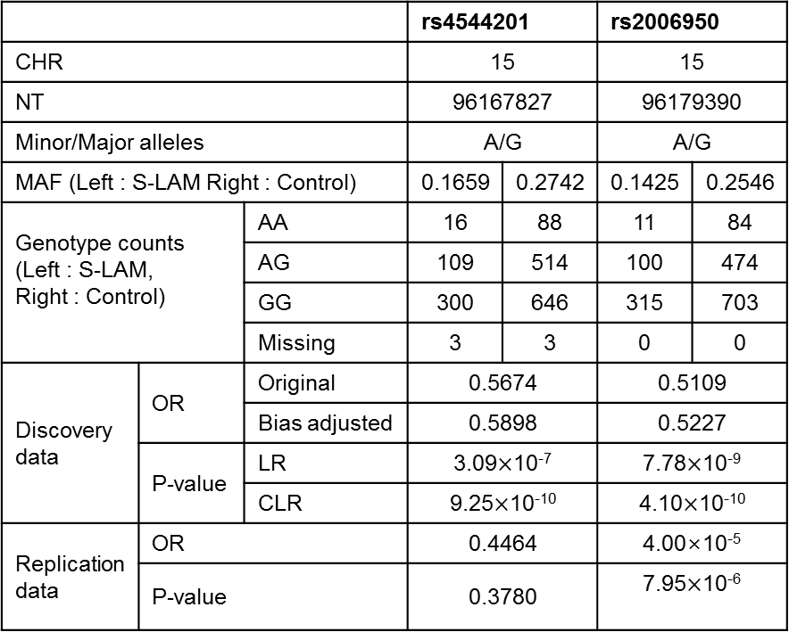
 |  |  | rs4544201 |  | rs2006950
CHR |  |  | 15 |  | 15
NT |  |  | 96167827 |  | 96179390
Minor/Major alleles |  |  | A/G |  | A/G
MAF (Left : S-LAM Right : Control) |  |  | 0.1659 | 0.2742 | 0.1425 | 0.2546
Genotype counts (Left : S-LAM, Right : Control) |  | AA | 16 | 88 | 11 | 84
 |  | AG | 109 | 514 | 100 | 474
 |  | GG | 300 | 646 | 315 | 703
 |  | Missing | 3 | 3 | 0 | 0
Discovery data | OR | Original | 0.5674 |  | 0.5109
 |  | Bias adjusted | 0.5898 |  | 0.5227
 | P-value | LR | 3.09$×$10⁻⁷ |  | 7.78$×$10⁻⁹
 |  | CLR | 9.25$×$10⁻¹⁰ |  | 4.10$×$10⁻¹⁰
Replication data | OR |  | 0.4464 |  | 4.00×10⁻⁵
 | P-value |  | 0.3780 |  | 7.95$×$10⁻⁶

Slide 5
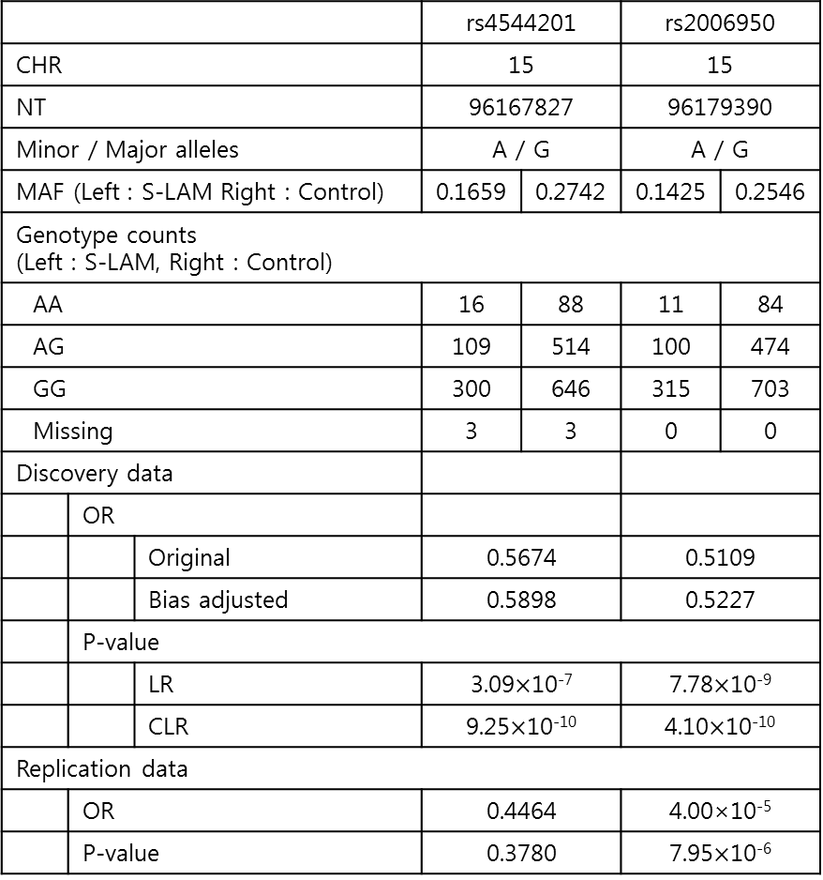
 |  |  | rs4544201 |  | rs2006950
CHR |  |  | 15 |  | 15
NT |  |  | 96167827 |  | 96179390
Minor / Major alleles |  |  | A / G |  | A / G
MAF (Left : S-LAM Right : Control) |  |  | 0.1659 | 0.2742 | 0.1425 | 0.2546
Genotype counts (Left : S-LAM, Right : Control)
AA |  |  | 16 | 88 | 11 | 84
AG |  |  | 109 | 514 | 100 | 474
GG |  |  | 300 | 646 | 315 | 703
Missing |  |  | 3 | 3 | 0 | 0
Discovery data
 | OR
 |  | Original | 0.5674 |  | 0.5109
 |  | Bias adjusted | 0.5898 |  | 0.5227
 | P-value
 |  | LR | 3.09$×$10⁻⁷ |  | 7.78$×$10⁻⁹
 |  | CLR | 9.25$×$10⁻¹⁰ |  | 4.10$×$10⁻¹⁰
Replication data
 | OR |  | 0.4464 |  | 4.00×10⁻⁵
 | P-value |  | 0.3780 |  | 7.95$×$10⁻⁶

Slide 6
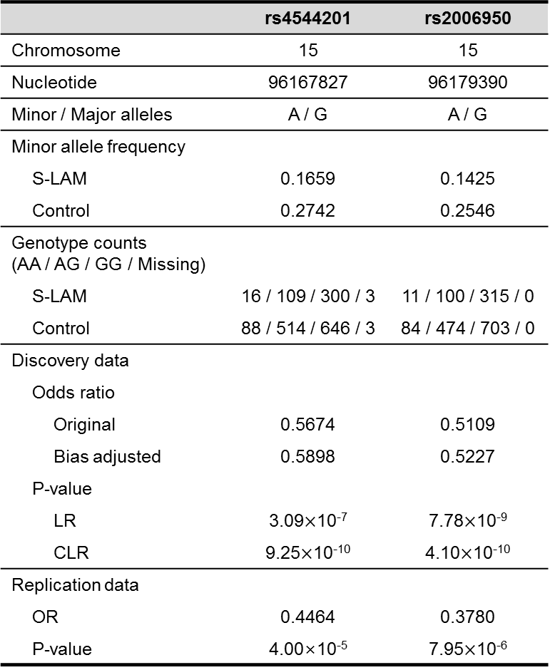
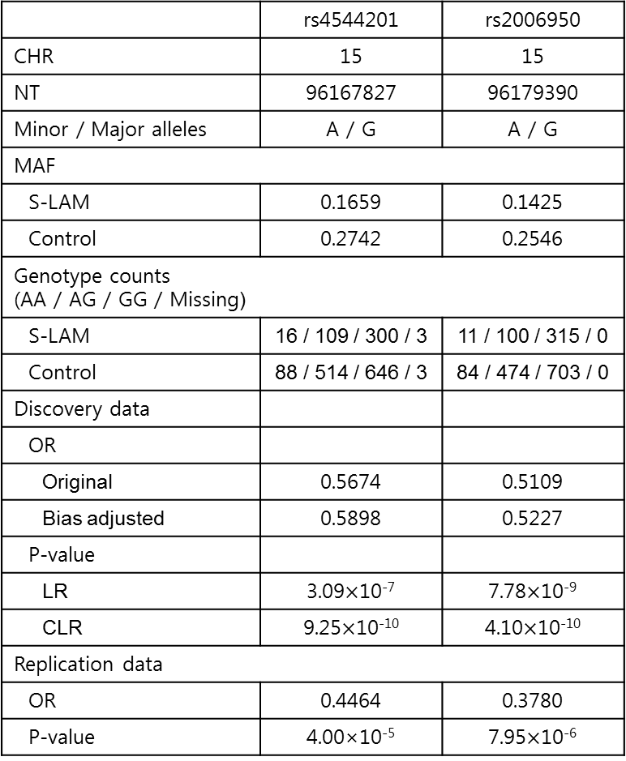
 | rs4544201 | rs2006950
CHR | 15 | 15
NT | 96167827 | 96179390
Minor / Major alleles | A / G | A / G
MAF
S-LAM | 0.1659 | 0.1425
Control | 0.2742 | 0.2546
Genotype counts (AA / AG / GG / Missing)
S-LAM | 16 / 109 / 300 / 3 | 11 / 100 / 315 / 0
Control | 88 / 514 / 646 / 3 | 84 / 474 / 703 / 0
Discovery data
OR
Original | 0.5674 | 0.5109
Bias adjusted | 0.5898 | 0.5227
P-value
LR | 3.09$×$10⁻⁷ | 7.78$×$10⁻⁹
CLR | 9.25$×$10⁻¹⁰ | 4.10$×$10⁻¹⁰
Replication data
OR | 0.4464 | 0.3780
P-value | 4.00×10⁻⁵ | 7.95$×$10⁻⁶
 | rs4544201 | rs2006950
Chromosome | 15 | 15
Nucleotide | 96167827 | 96179390
Minor / Major alleles | A / G | A / G
Minor allele frequency
S-LAM | 0.1659 | 0.1425
Control | 0.2742 | 0.2546
Genotype counts (AA / AG / GG / Missing)
S-LAM | 16 / 109 / 300 / 3 | 11 / 100 / 315 / 0
Control | 88 / 514 / 646 / 3 | 84 / 474 / 703 / 0
Discovery data
Odds ratio
Original | 0.5674 | 0.5109
Bias adjusted | 0.5898 | 0.5227
P-value
LR | 3.09$×$10⁻⁷ | 7.78$×$10⁻⁹
CLR | 9.25$×$10⁻¹⁰ | 4.10$×$10⁻¹⁰
Replication data
OR | 0.4464 | 0.3780
P-value | 4.00×10⁻⁵ | 7.95$×$10⁻⁶

Slide 7
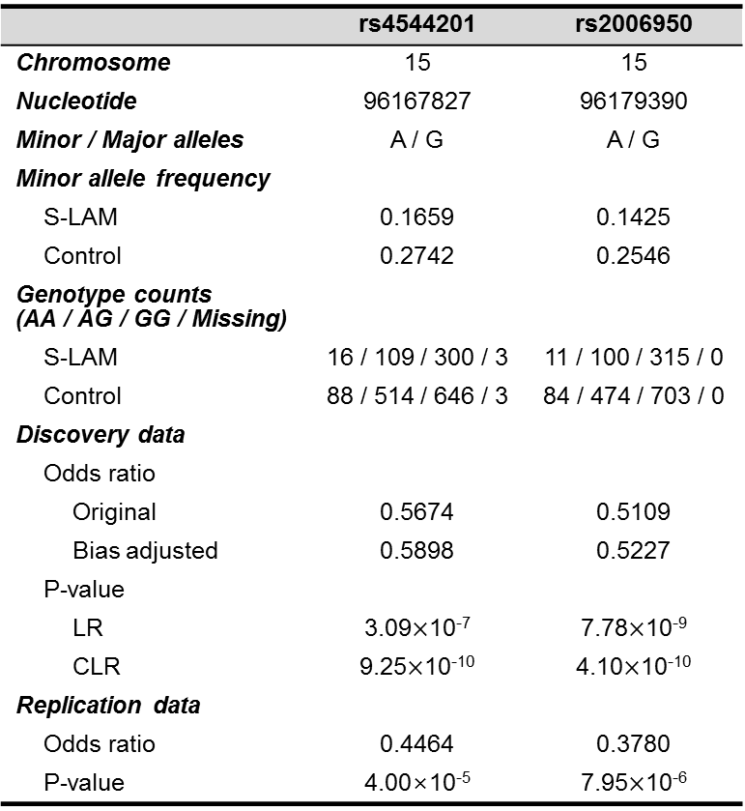

 | rs4544201 | rs2006950
Chromosome | 15 | 15
Nucleotide | 96167827 | 96179390
Minor / Major alleles | A / G | A / G
Minor allele frequency
S-LAM | 0.1659 | 0.1425
Control | 0.2742 | 0.2546
Genotype counts (AA / AG / GG / Missing)
S-LAM | 16 / 109 / 300 / 3 | 11 / 100 / 315 / 0
Control | 88 / 514 / 646 / 3 | 84 / 474 / 703 / 0
Discovery data
Odds ratio
Original | 0.5674 | 0.5109
Bias adjusted | 0.5898 | 0.5227
P-value
LR | 3.09$×$10⁻⁷ | 7.78$×$10⁻⁹
CLR | 9.25$×$10⁻¹⁰ | 4.10$×$10⁻¹⁰
Replication data
Odds ratio | 0.4464 | 0.3780
P-value | 4.00×10⁻⁵ | 7.95$×$10⁻⁶
 | rs4544201 | rs2006950
Chromosome | 15 | 15
Nucleotide | 96167827 | 96179390
Minor / Major alleles | A / G | A / G
Minor allele frequency
S-LAM | 0.1659 | 0.1425
Control | 0.2742 | 0.2546
Genotype counts (AA / AG / GG / Missing)
S-LAM | 16 / 109 / 300 / 3 | 11 / 100 / 315 / 0
Control | 88 / 514 / 646 / 3 | 84 / 474 / 703 / 0
Discovery data
Odds ratio
Original | 0.5674 | 0.5109
Bias adjusted | 0.5898 | 0.5227
P-value
LR | 3.09$×$10⁻⁷ | 7.78$×$10⁻⁹
CLR | 9.25$×$10⁻¹⁰ | 4.10$×$10⁻¹⁰
Replication data
Odds ratio | 0.4464 | 0.3780
P-value | 4.00×10⁻⁵ | 7.95$×$10⁻⁶

Slide 8
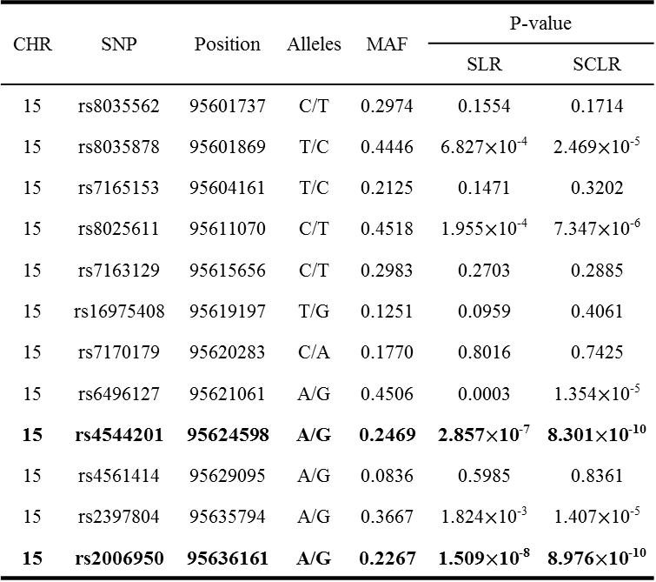
Table 2. SNPs within the LD block in discovery dataset
CHR | SNP | Position | Alleles | MAF | P-value
 |  |  |  |  | SLR | SCLR
15 | rs8035562 | 95601737 | C/T | 0.2974 | 0.1554 | 0.1714
15 | rs8035878 | 95601869 | T/C | 0.4446 | 6.827$×$10⁻⁴ | 2.469$×$10⁻⁵
15 | rs7165153 | 95604161 | T/C | 0.2125 | 0.1471 | 0.3202
15 | rs8025611 | 95611070 | C/T | 0.4518 | 1.955$×$10⁻⁴ | 7.347$×$10⁻⁶
15 | rs7163129 | 95615656 | C/T | 0.2983 | 0.2703 | 0.2885
15 | rs16975408 | 95619197 | T/G | 0.1251 | 0.0959 | 0.4061
15 | rs7170179 | 95620283 | C/A | 0.1770 | 0.8016 | 0.7425
15 | rs6496127 | 95621061 | A/G | 0.4506 | 0.0003 | 1.354$×$10⁻⁵
15 | rs4544201 | 95624598 | A/G | 0.2469 | 2.857$×$10⁻⁷ | 8.301$×$10⁻¹⁰
15 | rs4561414 | 95629095 | A/G | 0.0836 | 0.5985 | 0.8361
15 | rs2397804 | 95635794 | A/G | 0.3667 | 1.824$×$10⁻³ | 1.407$×$10⁻⁵
15 | rs2006950 | 95636161 | A/G | 0.2267 | 1.509$×$10⁻⁸ | 8.976$×$10⁻¹⁰

Slide 9
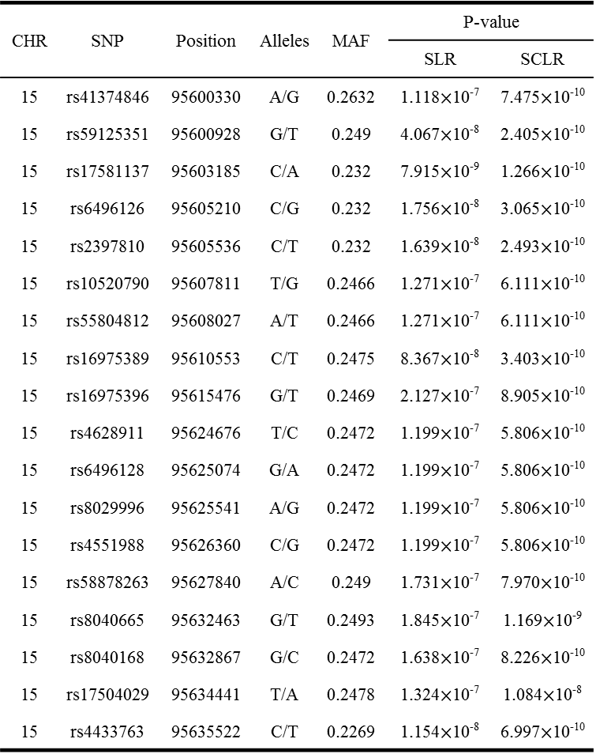
Table 3. Significant associations for imputed SNPs
CHR | SNP | Position | Alleles | MAF | P-value
 |  |  |  |  | SLR | SCLR
15 | rs41374846 | 95600330 | A/G | 0.2632 | 1.118$×$10⁻⁷ | 7.475$×$10⁻¹⁰
15 | rs59125351 | 95600928 | G/T | 0.249 | 4.067$×$10⁻⁸ | 2.405$×$10⁻¹⁰
15 | rs17581137 | 95603185 | C/A | 0.232 | 7.915$×$10⁻⁹ | 1.266$×$10⁻¹⁰
15 | rs6496126 | 95605210 | C/G | 0.232 | 1.756$×$10⁻⁸ | 3.065$×$10⁻¹⁰
15 | rs2397810 | 95605536 | C/T | 0.232 | 1.639$×$10⁻⁸ | 2.493$×$10⁻¹⁰
15 | rs10520790 | 95607811 | T/G | 0.2466 | 1.271$×$10⁻⁷ | 6.111$×$10⁻¹⁰
15 | rs55804812 | 95608027 | A/T | 0.2466 | 1.271$×$10⁻⁷ | 6.111$×$10⁻¹⁰
15 | rs16975389 | 95610553 | C/T | 0.2475 | 8.367$×$10⁻⁸ | 3.403$×$10⁻¹⁰
15 | rs16975396 | 95615476 | G/T | 0.2469 | 2.127$×$10⁻⁷ | 8.905$×$10⁻¹⁰
15 | rs4628911 | 95624676 | T/C | 0.2472 | 1.199$×$10⁻⁷ | 5.806$×$10⁻¹⁰
15 | rs6496128 | 95625074 | G/A | 0.2472 | 1.199$×$10⁻⁷ | 5.806$×$10⁻¹⁰
15 | rs8029996 | 95625541 | A/G | 0.2472 | 1.199$×$10⁻⁷ | 5.806$×$10⁻¹⁰
15 | rs4551988 | 95626360 | C/G | 0.2472 | 1.199$×$10⁻⁷ | 5.806$×$10⁻¹⁰
15 | rs58878263 | 95627840 | A/C | 0.249 | 1.731$×$10⁻⁷ | 7.970$×$10⁻¹⁰
15 | rs8040665 | 95632463 | G/T | 0.2493 | 1.845$×$10⁻⁷ | 1.169$×$10⁻⁹
15 | rs8040168 | 95632867 | G/C | 0.2472 | 1.638$×$10⁻⁷ | 8.226$×$10⁻¹⁰
15 | rs17504029 | 95634441 | T/A | 0.2478 | 1.324$×$10⁻⁷ | 1.084$×$10⁻⁸
15 | rs4433763 | 95635522 | C/T | 0.2269 | 1.154$×$10⁻⁸ | 6.997$×$10⁻¹⁰

Slide 10
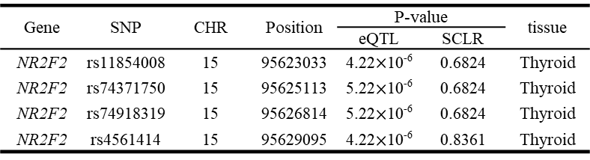
Table 4
Gene | SNP | CHR | Position | P-value |  | tissue
 |  |  |  | eQTL | SCLR
NR2F2 | rs11854008 | 15 | 95623033 | 4.22$×$10⁻⁶ | 0.6824 | Thyroid
NR2F2 | rs74371750 | 15 | 95625113 | 5.22$×$10⁻⁶ | 0.6824 | Thyroid
NR2F2 | rs74918319 | 15 | 95626814 | 5.22$×$10⁻⁶ | 0.6824 | Thyroid
NR2F2 | rs4561414 | 15 | 95629095 | 4.22$×$10⁻⁶ | 0.8361 | Thyroid

Slide 11
Table 5.
CHR | SNP | Position | Alleles | MAF | OR (SLR) | P-value
 |  |  |  |  |  | SLR | SCLR
15 | rs3743462 | 96327588 | G/A | 0.1522 | 0.7520 | 0.0286 | 0.0558
15 | rs3809557 | 96329983 | A/G | 0.2783 | 0.7941 | 0.0223 | 0.0205
15 | rs1807198 | 96335065 | G/A | 0.2365 | 0.8739 | 0.2023 | 0.2148
15 | rs2001191 | 96335120 | C/T | 0.2165 | 0.8089 | 0.0567 | 0.0390
15 | rs11045 | 96340092 | T/G | 0.2244 | 1.0330 | 0.7583 | 0.4436

Slide 12
Table 6. PICS SNPs
CHR | PICS_SNPs | Position | PICS probability
 |  |  | rs4544201 | rs206950
15 | rs2006950 | 96179390 | 0.0162 | 0.2927
15 | rs4544201 | 96167827 | 0.1529 | 0.0313
15 | rs4433763 | 96178751 | 0.019 | 0.151
15 | rs8029996 | 96168770 | 0.0804 | 0.0273
15 | rs6496128 | 96168303 | 0.0804 | 0.0273
15 | rs4628911 | 96167905 | 0.0804 | 0.0273
15 | rs58878263 | 96171069 | 0.0694 | 0.0255
15 | rs4551988 | 96169589 | 0.0612 | 0.0238
15 | rs8040665 | 96175692 | 0.0544 | 0.0296
15 | rs34488045 | - | 0.0541 | 0.0213
15 | rs17504029 | 96177670 | - | 0.0491
15 | rs16975396 | 96158705 | 0.0403 | 0.0178
15 | rs16975389 | 96153782 | 0.0337 | 0.0153
15 | rs8040168 | 96176096 | 0.0334 | 0.0308
15 | rs55804812 | 96151256 | 0.0311 | 0.0144
15 | rs2397810 | 96148765 | 0.0175 | 0.0301
15 | rs10520790 | 96151040 | 0.0287 | 0.0135
15 | rs8039789 | 96175483 | 0.0282 | 0.0269
15 | rs17581137 | 96146414 | 0.0151 | 0.0259
15 | rs6496126 | 96148439 | 0.013 | 0.0225
15 | rs59125351 | 96144157 | 0.0208 | -

Slide 13
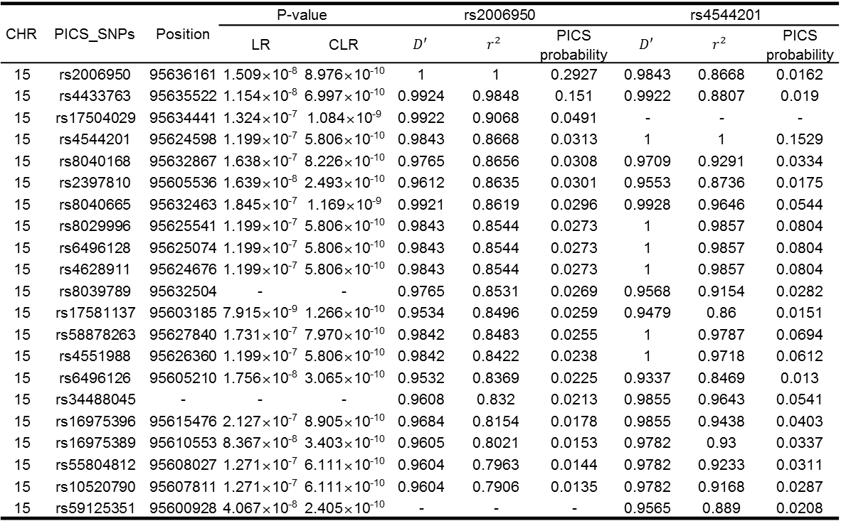
CHR | PICS_SNPs | Position | P-value |  | rs2006950 |  |  | rs4544201
 |  |  | LR | CLR | $$D′$$ | $$r^{2}$$ | PICS probability | $$D′$$ | $$r^{2}$$ | PICS probability
15 | rs2006950 | 95636161 | 1.509×10⁻⁸ | 8.976×10⁻¹⁰ | 1 | 1 | 0.2927 | 0.9843 | 0.8668 | 0.0162
15 | rs4433763 | 95635522 | 1.154×10⁻⁸ | 6.997×10⁻¹⁰ | 0.9924 | 0.9848 | 0.151 | 0.9922 | 0.8807 | 0.019
15 | rs17504029 | 95634441 | 1.324×10⁻⁷ | 1.084×10⁻⁹ | 0.9922 | 0.9068 | 0.0491 | - | - | -
15 | rs4544201 | 95624598 | 1.199×10⁻⁷ | 5.806×10⁻¹⁰ | 0.9843 | 0.8668 | 0.0313 | 1 | 1 | 0.1529
15 | rs8040168 | 95632867 | 1.638×10⁻⁷ | 8.226×10⁻¹⁰ | 0.9765 | 0.8656 | 0.0308 | 0.9709 | 0.9291 | 0.0334
15 | rs2397810 | 95605536 | 1.639×10⁻⁸ | 2.493×10⁻¹⁰ | 0.9612 | 0.8635 | 0.0301 | 0.9553 | 0.8736 | 0.0175
15 | rs8040665 | 95632463 | 1.845×10⁻⁷ | 1.169×10⁻⁹ | 0.9921 | 0.8619 | 0.0296 | 0.9928 | 0.9646 | 0.0544
15 | rs8029996 | 95625541 | 1.199×10⁻⁷ | 5.806×10⁻¹⁰ | 0.9843 | 0.8544 | 0.0273 | 1 | 0.9857 | 0.0804
15 | rs6496128 | 95625074 | 1.199×10⁻⁷ | 5.806×10⁻¹⁰ | 0.9843 | 0.8544 | 0.0273 | 1 | 0.9857 | 0.0804
15 | rs4628911 | 95624676 | 1.199×10⁻⁷ | 5.806×10⁻¹⁰ | 0.9843 | 0.8544 | 0.0273 | 1 | 0.9857 | 0.0804
15 | rs8039789 | 95632504 | - | - | 0.9765 | 0.8531 | 0.0269 | 0.9568 | 0.9154 | 0.0282
15 | rs17581137 | 95603185 | 7.915×10⁻⁹ | 1.266×10⁻¹⁰ | 0.9534 | 0.8496 | 0.0259 | 0.9479 | 0.86 | 0.0151
15 | rs58878263 | 95627840 | 1.731×10⁻⁷ | 7.970×10⁻¹⁰ | 0.9842 | 0.8483 | 0.0255 | 1 | 0.9787 | 0.0694
15 | rs4551988 | 95626360 | 1.199×10⁻⁷ | 5.806×10⁻¹⁰ | 0.9842 | 0.8422 | 0.0238 | 1 | 0.9718 | 0.0612
15 | rs6496126 | 95605210 | 1.756×10⁻⁸ | 3.065×10⁻¹⁰ | 0.9532 | 0.8369 | 0.0225 | 0.9337 | 0.8469 | 0.013
15 | rs34488045 | - | - | - | 0.9608 | 0.832 | 0.0213 | 0.9855 | 0.9643 | 0.0541
15 | rs16975396 | 95615476 | 2.127×10⁻⁷ | 8.905×10⁻¹⁰ | 0.9684 | 0.8154 | 0.0178 | 0.9855 | 0.9438 | 0.0403
15 | rs16975389 | 95610553 | 8.367×10⁻⁸ | 3.403×10⁻¹⁰ | 0.9605 | 0.8021 | 0.0153 | 0.9782 | 0.93 | 0.0337
15 | rs55804812 | 95608027 | 1.271×10⁻⁷ | 6.111×10⁻¹⁰ | 0.9604 | 0.7963 | 0.0144 | 0.9782 | 0.9233 | 0.0311
15 | rs10520790 | 95607811 | 1.271×10⁻⁷ | 6.111×10⁻¹⁰ | 0.9604 | 0.7906 | 0.0135 | 0.9782 | 0.9168 | 0.0287
15 | rs59125351 | 95600928 | 4.067×10⁻⁸ | 2.405×10⁻¹⁰ | - | - | - | 0.9565 | 0.889 | 0.0208

Slide 14
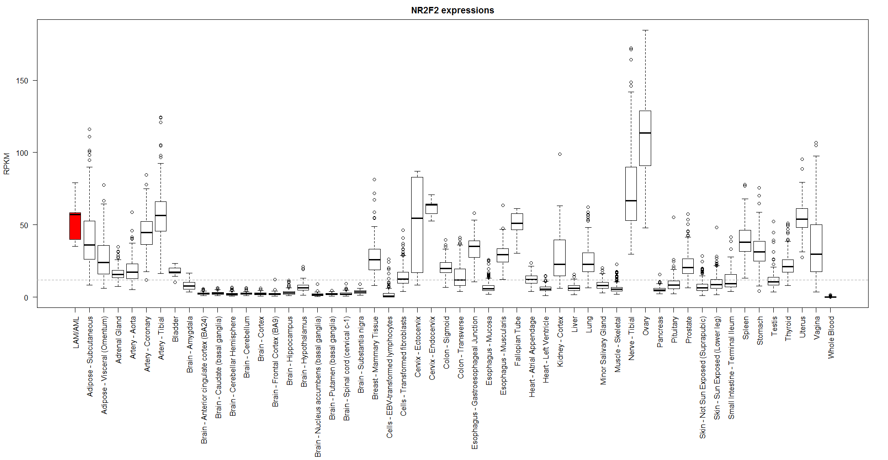
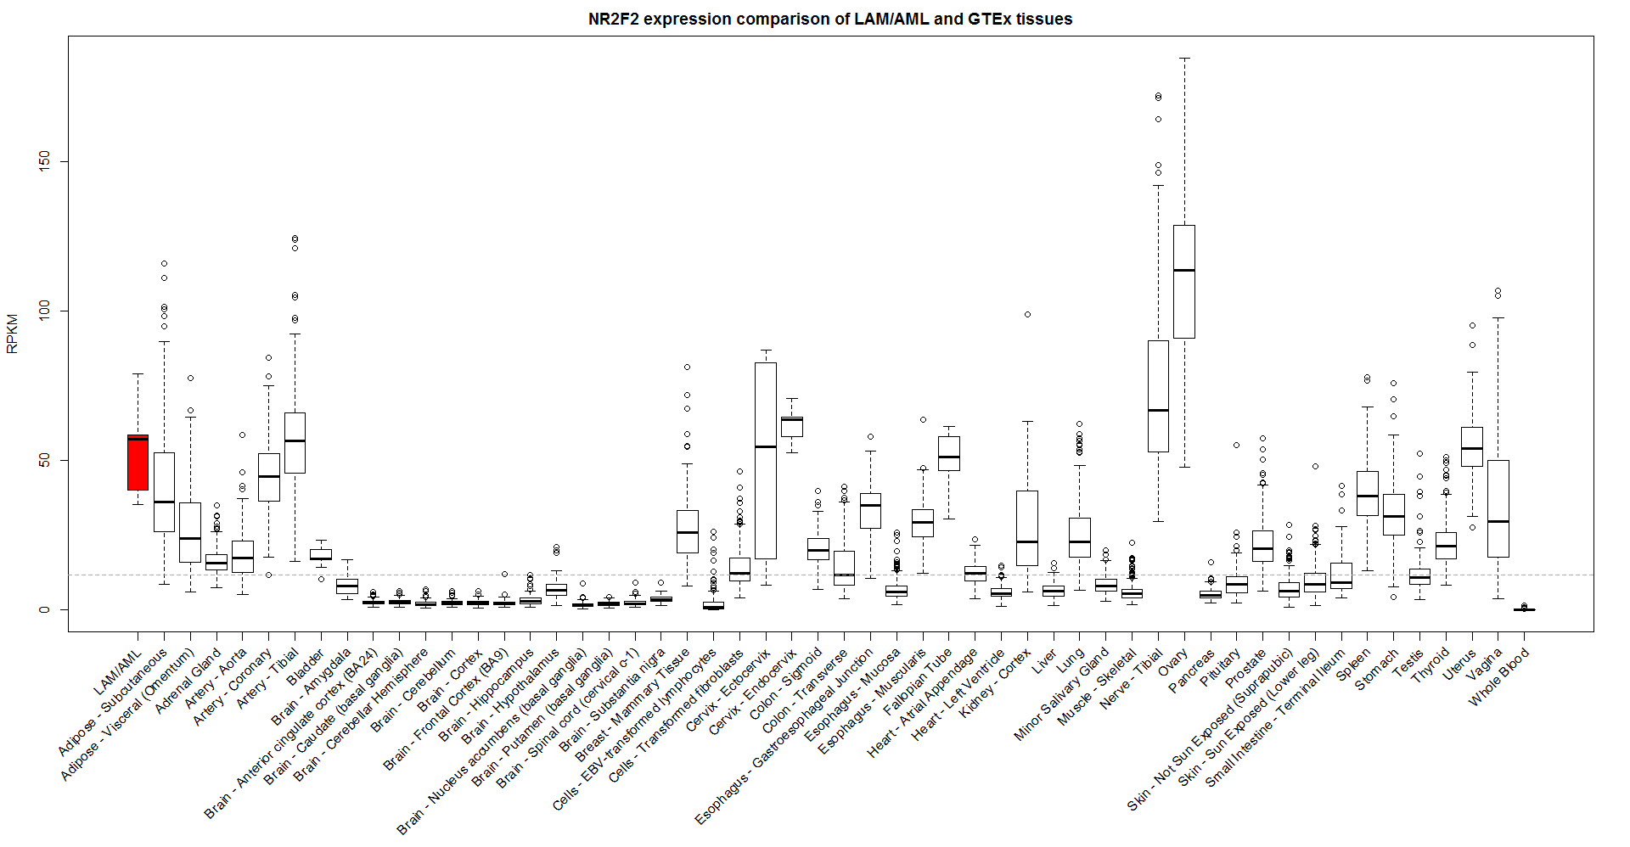
B

Slide 15
A

Slide 16
A
B

Slide 17
rs4544201
Dataset | Female |  | Male |  | P-value for CA test
 | N | MAF (95% CI) | N | MAF (95% CI)
COPDGene (NHW) | 1,258 | 0.2742 (0.257 – 0.292) | 1,224 | 0.2774 (0.260 – 0.295) | 0.8036
MESA | 1,153 | 0.2563 (0.238 – 0.274) | 1,088 | 0.2661 (0.248 – 0.285) | 0.4514
1000 Genome (EUR) | 792 | 0.2357 (0.215 – 0.257) | 1,367 | 0.2313 (0.215 – 0.247) | 0.8638
ECLIPSE | 792 | 0.2563 (0.235 – 0.278) | 1,367 | 0.2637 (0.247 – 0.280) | 0.5875
rs2006950
Dataset | Female |  | Male |  | P-value for CA test
 | N | MAF (95% CI) | N | MAF (95% CI)
COPDGene (NHW) | 1,261 | 0.2546 (0.238 – 0.272) | 1,226 | 0.2557 (0.238 – 0.273) | 0.9258
MESA | 1,128 | 0.2283 (0.211 – 0.246) | 1,080 | 0.2451 (0.227 – 0.263) | 0.1889
1000 Genome (EUR) | 792 | 0.2186 (0.198 – 0.239) | 1,367 | 0.2083 (0.193 – 0.224) | 0.6872
ECLIPSE | 792 | 0.2431 (0.222 – 0.264) | 1,367 | 0.2465 (0.230 – 0.263) | 0.7959

Slide 18
SNP | Case |  |  | Control |  |  | P-value (CA Test)
 | Data | N | MAF (95% CI) | Data | N | MAF (95% CI)
rs4544201 | LAM Replication | 186 | 0.1429 (0.107 – 0.178) | COPDGene (NHW Male) | 1,224 | 0.2774 (0.260 – 0.295) | 3.28×10⁻¹¹
 |  |  |  | MESA (EUR Female) | 1,153 | 0.2563 (0.238 – 0.274) | 1.32×10⁻⁸
 |  |  |  | 1000GP (EUR Female) | 263 | 0.2357 (0.215 – 0.257) | 3.43×10⁻⁴
 |  |  |  | ECLIPSE (EUR Female) | 792 | 0.2563 (0.235 – 0.278) | 8.88×10⁻⁸
 |  |  |  | UKBiobank (EUR)
 |  |  |  | GnomAD (EUR) | 1,745 | 0.3424 (0.327 – 0.358) | 8.85×10⁻²⁴
rs2006950 | LAM Replication | 186 | 0.1148 (0.082– 0.147) | COPDGene (NHW Male) | 1,226 | 0.2557 (0.238 – 0.273) | 5.36×10⁻¹⁴
 |  |  |  | MESA (EUR Female) | 1,128 | 0.2283 (0.211 – 0.246) | 1.40×10⁻⁹
 |  |  |  | 1000GP (EUR Female) | 263 | 0.2186 (0.198 – 0.239) | 2.19×10⁻⁵
 |  |  |  | ECLIPSE (EUR Female) | 792 | 0.2431 (0.222 – 0.264) | 7.91×10⁻¹¹
 |  |  |  | UKBiobank (EUR)
 |  |  |  | GnomAD (EUR) | 1,747 | 0.3060 (0.289 – 0.323) | 1.28×10⁻²⁵

